Slide 1

L05 Problem Solving with Classes
teAch Bedeus LLC is licensed under a Creative Commons Attribution-NonCommercial-ShareAlike 3.0 Unported License

Slide 2

Today
Check in
Environment and Workshop
M01 L04 UPDATED 2D Arrays and Static variables
Goals
Design classes using UML and use Test Driven Development to implement and unit test solution.
Write readable, maintainable code following industry coding standards (naming, indentation, comments).
Create a program using an IDE with Debugger, version control (Git/GitHub), and Javadoc documentation.
Set Up
Open this lecture and download the following and put in repo
GE M01 Part 2 Apply and 3 Reflect
CS2050 Agile Software Development (You might want to download as PDF
Open Eclipse (or your IDE) or Visualize Java Code
What did you do for fun this weekend?

Slide 3
In main method
BasicRectangle rectangle1 = new BasicRectangle();
rectangle1.setLength(8.5);
rectangle1.setWidth(5.2);
System.out.printf("Rectangle width: %.1f and height: %.1f\n",
rectangle1.getWidth(), rectangle1.getLength());
BasicRectangle rectangle2 = new BasicRectangle(4, 5);
System.out.println("The area of the rectangle 2 is " + rectangle2.getArea());
System.out.println("The perimeter of the rectangle 2 is " + rectangle1.getPerimeter());
public double getLength() {
return this.length;
}
public double getWidth() {
return this.width;
}
public void setWidth(double width) {
this.width = width;
}
public void setLength(double length) {
this.length = length;
}
public double getArea() {
return this.length * this.width;
}
public double getPerimeter() {
return 2* (this.width + this.length);
}
public static int getNumberOfRectangles() {
return numberOfRectangles;
}
}// BasicRectangle Class
Rotate in group to discuss the object oriented concepts
class BasicRectangle {
private double length = 1;
private double width = 1;
private static int numberOfRectangles = 0;
public BasicRectangle() {
numberOfRectangles++;
}
public BasicRectangle(double length, double width) {
this.length = length;
this.width = width;
numberOfRectangles++;
}

Slide 4

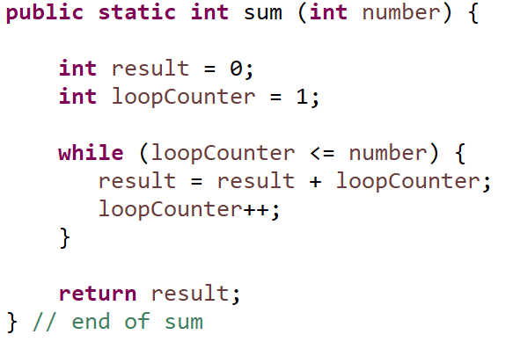
Review Scope
Section of a program that a variable is visible in
Local Variable
Variable that is defined inside a method
Scope is from point of declaration to end of block containing the variable
Must be initialized before you can use it
Notes
Formal parameters are considered local variables
General rule - the scope of a variable declared in a block is limited to that block
If you try to use a variable outside the block it is declared, you will get a compiler error

Slide 5
Scope
The different types of variables in a Java program are:
Local variables - declared in a method
Instance variables - declared within a class
Static variables - declared within a class
Scope in Context of a Class
Local variable - starts from its declaration and continues to the end of the block that contains the variable, such as
declared in for loop {block of code}
declared in method {block of code}
Instance variables and static variables scope is the entire class.

Slide 6
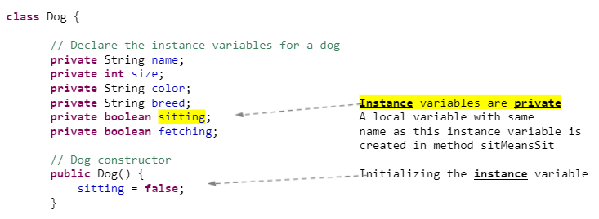
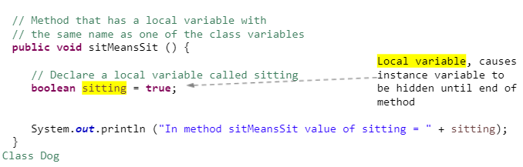
Instance and Local Variable with Same Name
The sitting instance variable is not the same memory location as the local variable in the sitMeansSit method.
If a local variable has the same name as an instance variable
The local variable takes precedence
The instance variable is hidden until the local variable goes out of scope

Slide 7
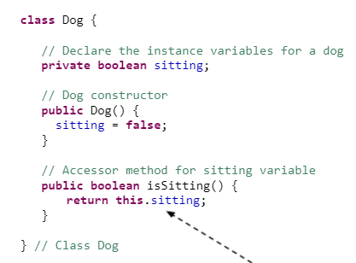

this
Keyword in java this is the name of a reference that refers to the object address itself when writing code in the class.
Or can be written
In this class, we use this reference when accessing the sitting instance (class) variable

Slide 8
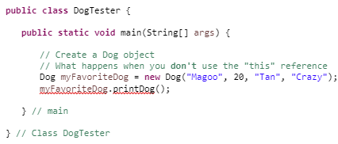
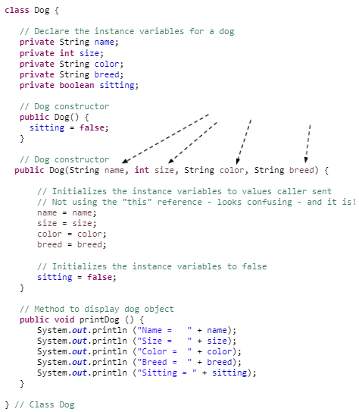
Use this to Refer to Hidden Fields
What is put in declared variables if not initialized?
Here's what happens if you don't use the this reference.
Since the instance variables were not set in the constructor they are set to default values.
Many times, we send in the name to a method that matches the name of an instance variable.
Displays
Name = null
Size = 0
Color = null
Breed = null
Sitting = false
The values coming into the parameters in the method are treated as local variables
The local variables have the same name as the instance variables, so the instance variables are hidden.
When I refer to "name" - I'm referring to the local variable called "name"
If I would put System.out.println statements in the constructor method I would see
Name = Magoo
Size = 20
Color = Tan
Breed = Crazy
Sitting = false
but the variables being set are the local not the instance!
The local variables were set to values passed to constructor. Cause problem

Slide 9
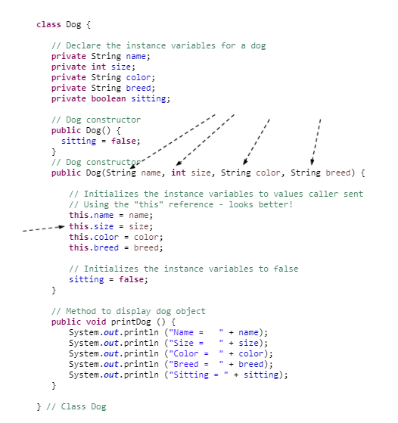
Refer to Hidden Fields with this reference
Using this reference in the constructor indicates to update the private instance variables with the passed local parameter variables.
Implement your instance variables to use this.

Slide 10
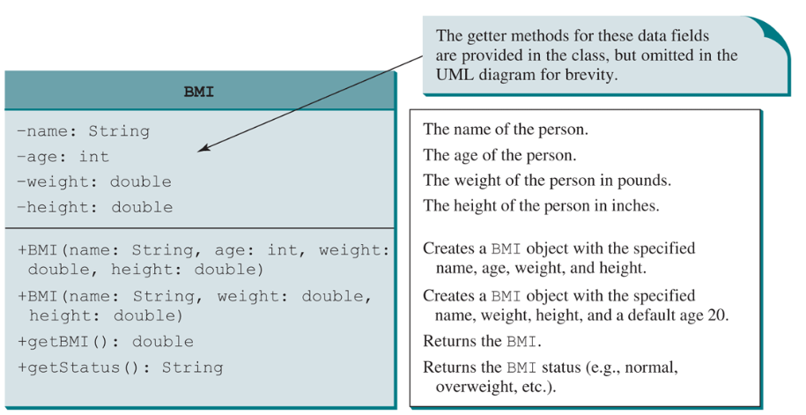
Designing with Classes
Procedural Programming: The focus is on designing methods
You wrote a program for computing the body mass index (BMI) earlier in the semester. The code cannot be reused in other programs, because the code is in the main method. To make it reusable, define a static method to compute body mass index as follows:
Suppose you need to associate the weight and height with a person’s name and birth date. You could declare separate variables to store these values, but these values would not be tightly coupled. The ideal way to couple them is to create an object that contains them all.
Object Oriented Programming: Focus is on objects and the operations that can be performed on that object

Slide 11

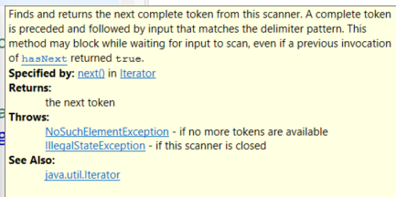
Class Abstraction and Encapsulation
Class abstraction means to separate class implementation from the use of the class. The creator of the class provides a description of the class and let the user know how the class can be used. The user of the class does not need to know how the class is implemented. The detail of implementation is encapsulated and hidden from the user.
You've experienced this with the predefined classes you have used such as Java Scanner class
You used a method on the class to perform a task such as
You had no idea or cared about how that method was implemented

Slide 12

Software Development Agile Approach
You will approach designing and implementing solutions following CS2050 Agile Software Development
Today we will do a lab to create a library app.
Don’t forget after class to look at the preparation in today’s lecture.
Next lecture will discuss storing objects in an array.

